Slide 1
Building, visualizing and classifying a NoSQL time series data store using InfluxDB2, Python and Grafana
Big Data & Machine Learning
Philipp Moritzer, 21.07.2022

Slide 2
Introduction
Fundamentals
NoSQL basics
NoSQL vs Relational Databases
Time Series Databases
InfluxDB basics
Flux query language
InfluxDB vs Timescale vs Prometheus
Naive Bayes Classification
Project
Live demonstration
Conclusion

Slide 3
1. Introduction
This project‘s goals

Slide 4
Introduction
Big data, IoT, real-time analytics are new types of data
As a result, new methods of storing this data have emerged
Almost all streaming data, particulary IoT data and application monitoring, have a timestamp
thus is time series data
This projects goes on to demonstrate how time series databases can be used in terms of:
Differences to to traditional relational databases
Why time series databases are used
How to build a project on top of them
The project:
Storing data in InfluxDB
Visualizing and classifying the data
Python, Grafana, InfluxDB2, Naive Bayes

Slide 5
2. Fundamentals
Understanding NoSQL databases, time series databases, InfluxDB and its capabilites

Slide 6
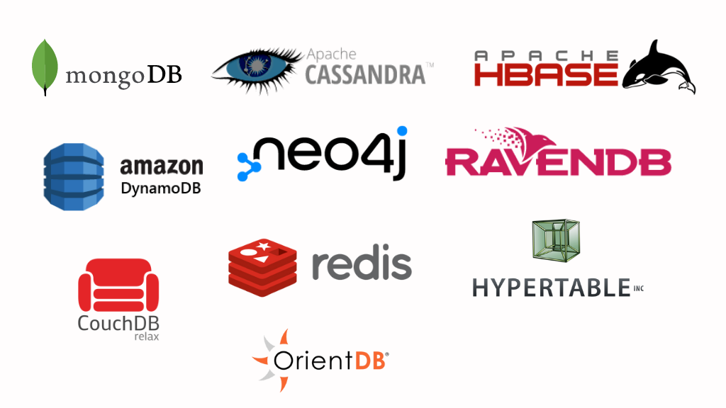
NoSQL basics
An approach to database design that excludes traditional relational database management systems
Efficient for specific data instead of abstracting the underlying data structure
No need to use a predefined schema
Resulting in simpler design, horizontal scaling and greater control over data
Distributed data storage
CAP-Theorem: Only two out of three attributes: consistency, availability, partition tolerance
Depending on the applications‘ needs
[1]

Slide 7
NoSQL vs Relational Databases
Share the same basic goal: Store and retrieve data, coordinate changes.
SQL | NoSQL
Abstraction through relational principle | No data abstraction (data-specific)
SQL Query Language | Custom query language
Lots of application code needed when distributing | Distributed by design
Pre-defined Schema | No Schema
Simple coordination properties | Might get complex fast
Inefficient when handling lots of unstructured data | Scalable by design, can handle loads of data

Slide 8



Time Series Databases
Grouping of values organized by time
Any event recorded over time (regular or irregular) is considered time series data
Designed to deal with high volume measurement data
Solve 3 major characteristics of data:
Exceptionally high volume
Natural time order
The entire set of data being more valuable than individual records
Optimizes on frequent writes, merging data and constructing sums and averages
Retention period
Optimzed query language
Solving the problem with SQL: Not designed to do frequent deletes
Popular time series databases:
[2]
[4]
[3]

Slide 9
InfluxDB basics
Most popular time series databases
Created 2013, Version 2 in 2020 with new Query Language and skyrocketing popularity
Standalone database system
Advertised for solving following problems:
Collecting and storing IoT and real-time data
Analysing data
High performance (million datapoints per seconds)
Timestamps in nanoseconds range

Slide 10
InfluxDB basics - Flux query language
Includes a query language for querying, analyzing and acting on data
Can perform various operations but a general query looks as follows:
from(bucket)
|> range (start: x, stop: y)
|> filter
The pipe symbol |> marks pipe forward data and every function or expression that follows takes the former expression as an input
A bucket is used for storing time series data in InfluxDB which will be choosen as source first
A time range to select is required
One can filter the data based on their requirements
Offers functions for reducing, summing, interpreting or mapping data
Therefore Flux can be used for data analytics

Slide 11
InfluxDB basics - Flux query language (example)
from(bucket: “bird-migration“)
|> range(start: 2021-01-01T00:00:00Z, stop: 2021-01-01T12:00:00Z)
|> filter (fn: (r) => r._measurement == "location" and r._field == "lat" and r.lat == "lat")

Slide 12
Comparing InfluxDB to other time series databases
[4]
[3]
Based on PostgreSQL
Uses SQL as query language
Relational data model
Inferior performance to InfluxDB
Query Language PromQL
More features for monitoring purposes
Less support for analytics or machine learning
Only milliseconds stamps vs InfluxDB‘s nanoseconds
Less resource usage
Cloud: AWS (Amazon timestream) or Azure(Azure Time Insights) prefer to use their cloud native database due to the infrastructure

Slide 13
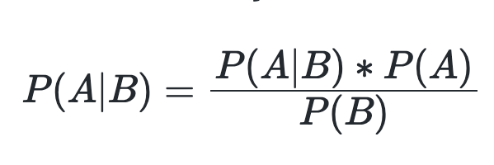
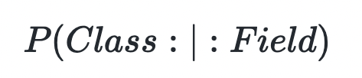
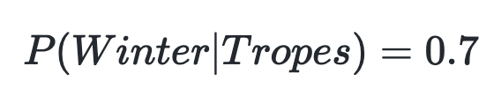
Classification using Naive Bayes
Probabilistic classifier that can predict a probable outcome of a class if a field is given.
Based on the Bayes Theorem:
A distribution over a set of classes is calculated given an observation of an input
The classifier can the be trained to determine which class has the highest probability
The class can be predicted given a field input
Example:

Slide 14
3. Project
Introducing the project implemented

Slide 15
Project - Overview
Process a large amount of time series data
NoSQL with InfluxDB
A Grafana Dashboard is contructed to visualize the data
The data will be parsed using Python and processed to InfluxDB
Using Functional Programming
Using the Python client library provided by InfluxDB
Classification with Flux

Slide 16
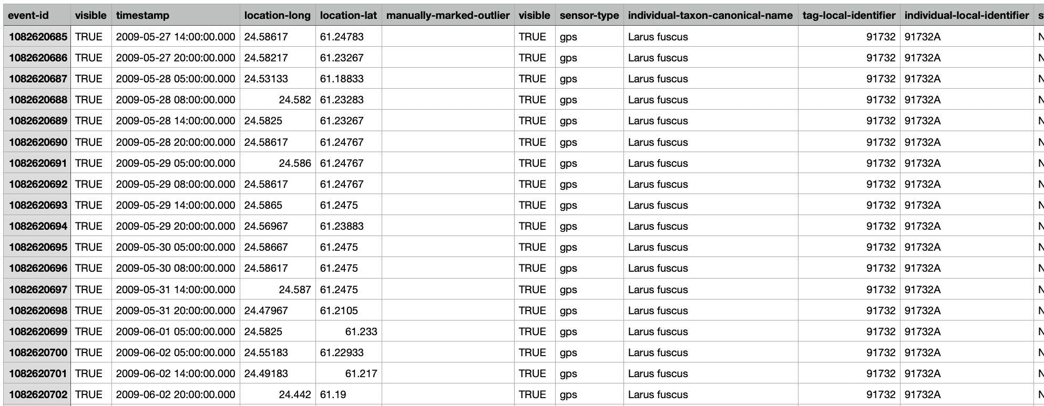
Project – The dataset
Values that represent measured bird locations over a series of time
Stored as a CSV-file
Contains 89869 measurements
Time range from 2009-2016
50 individual birds

Slide 17

Project - Overview
bird-migration-values.csv
Python Script
writes to
InfluxDB
Data source
Grafana
Functional Programming
InfluxDB Python Library
Flux
Visualization
Classification

Slide 18
Project - Overview
bird-migration-values.csv
Docker-compose
Python Script
writes to
InfluxDB
Data source
Grafana
Functional Programming
InfluxDB Python Library
Flux
Visualization
Classification

Slide 19
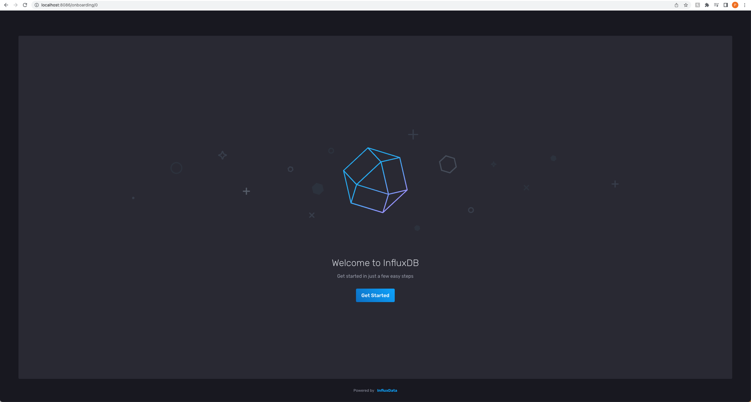
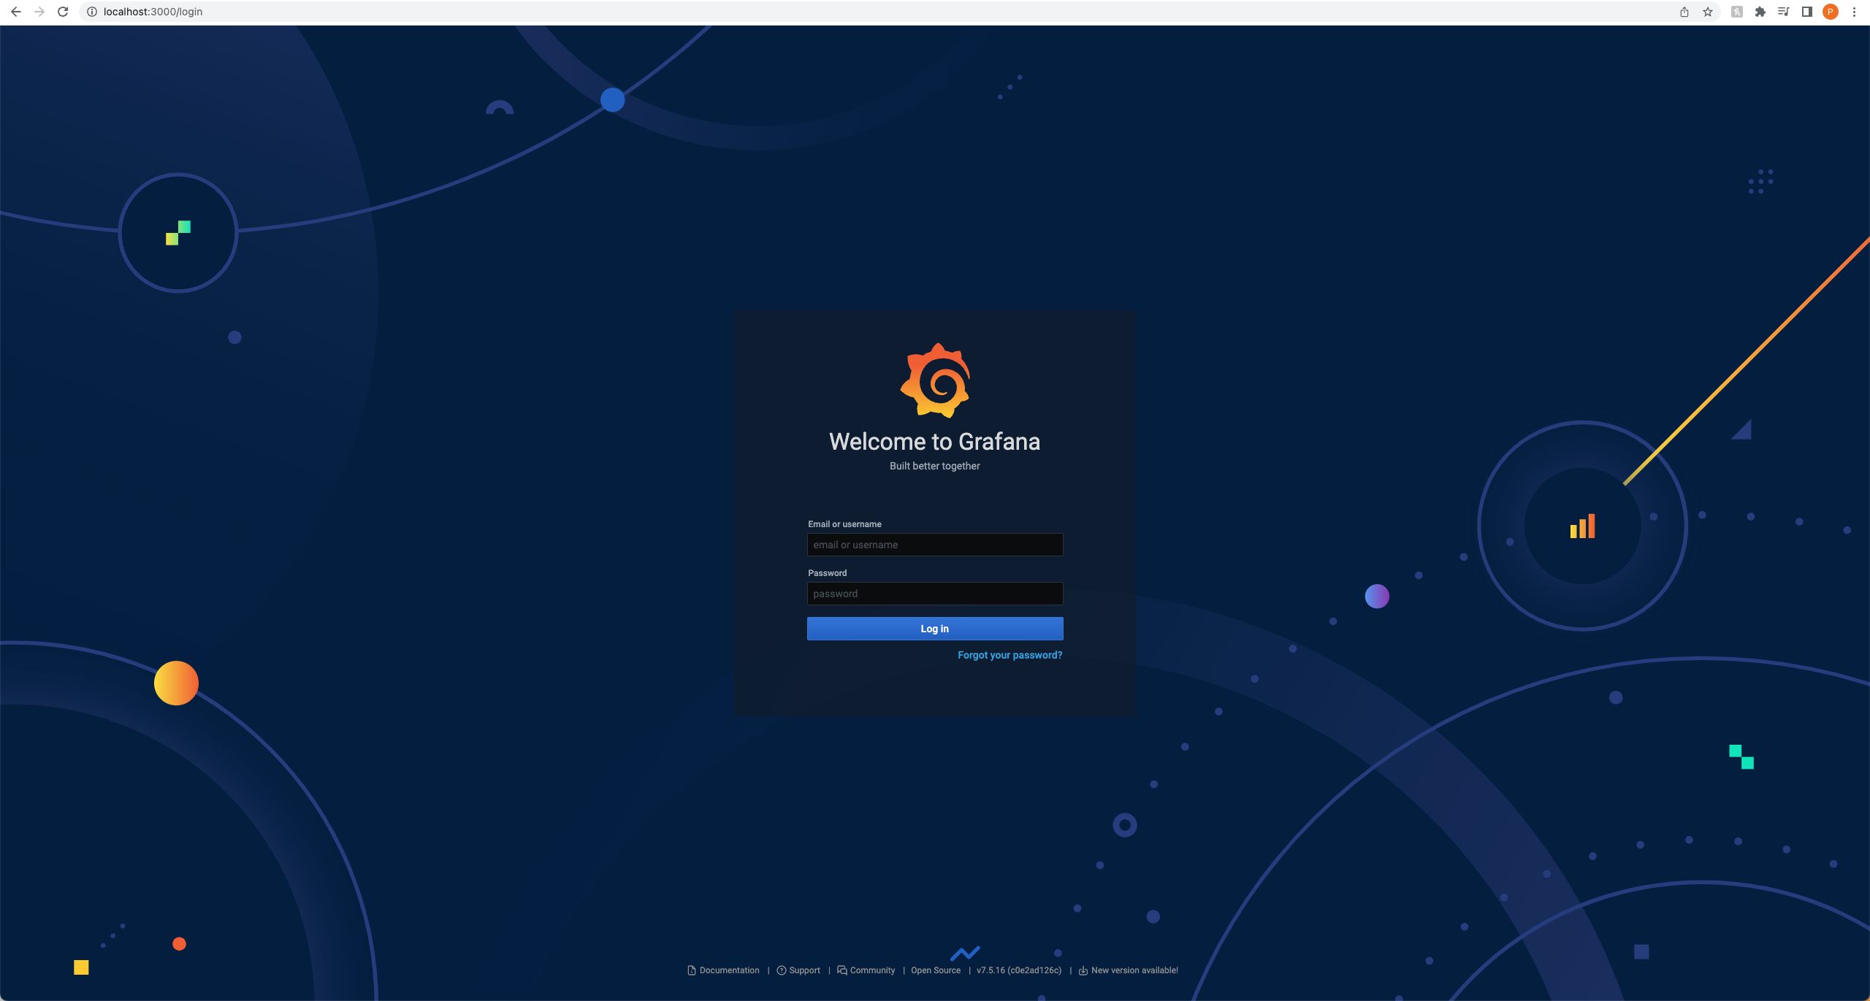
Project – Setting up the infrastructure
Local instances of InfluxDB and Grafana using Docker/docker-compose
Using official Docker images for InfluxDB and grafana
Therefore no installation necessary

Slide 20
Project – Importing the data
Python application
InfluxDB Client Library
Installed with pip
Functional Programming
Batch processing
Database retry mechanism
Dockerized

Slide 21
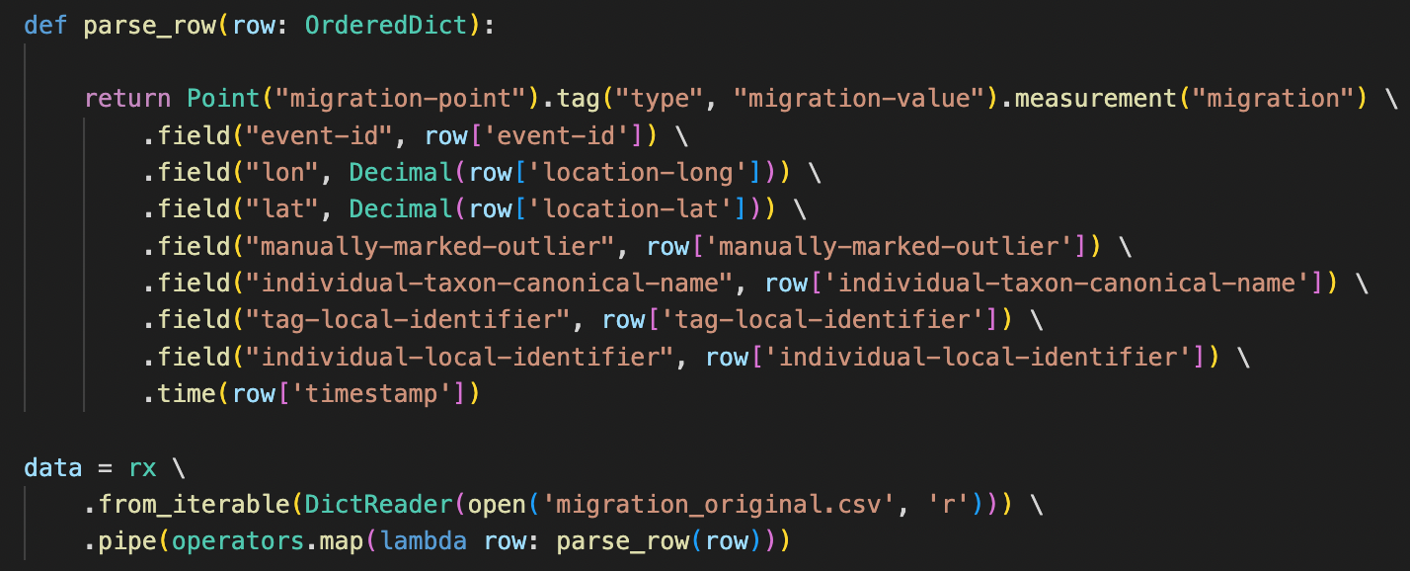
Project – Importing the data

Slide 22
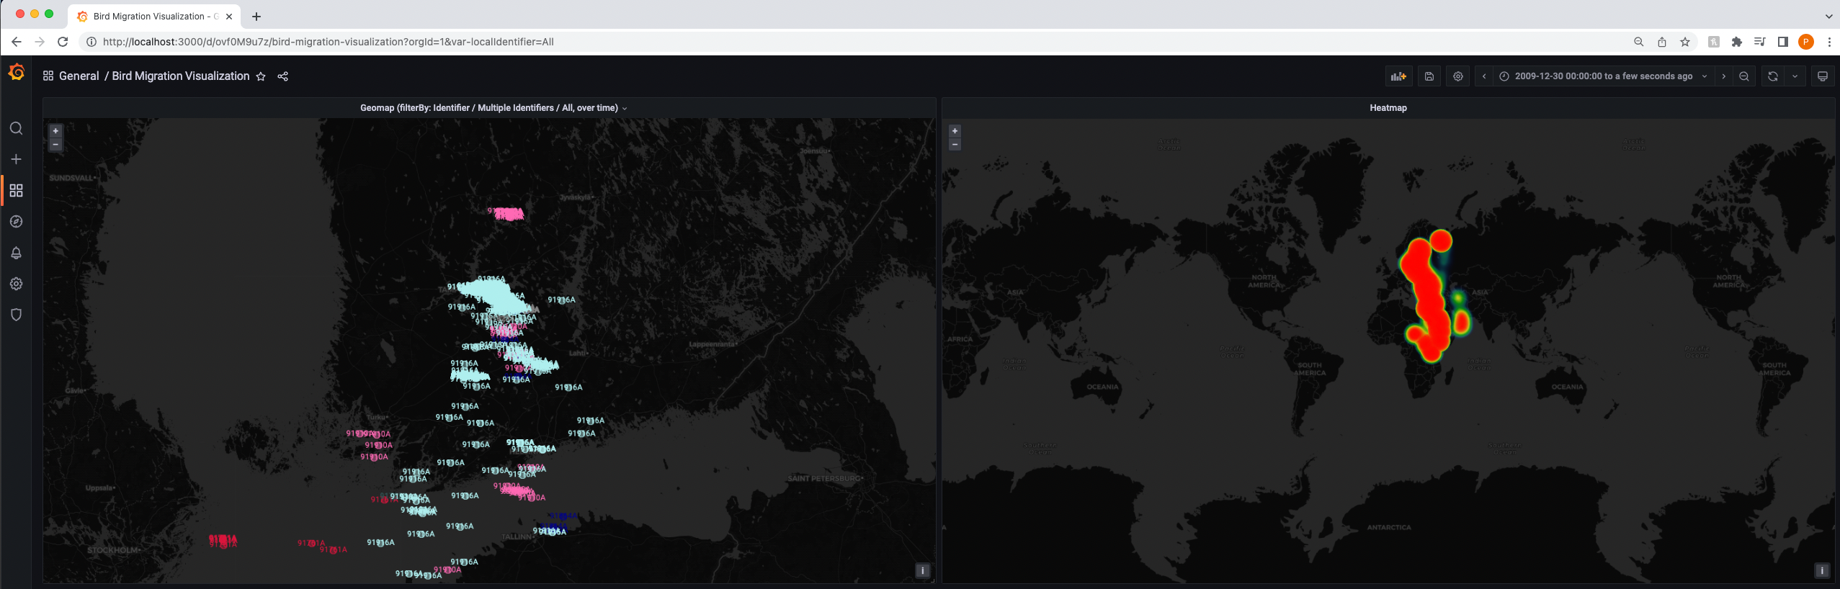
Project – visualization – GeoMap & Heatmap
Grafana GeoMap & Heatmap – visualizing the data entries on a map
Filterable by time and by bird identifier

Slide 23
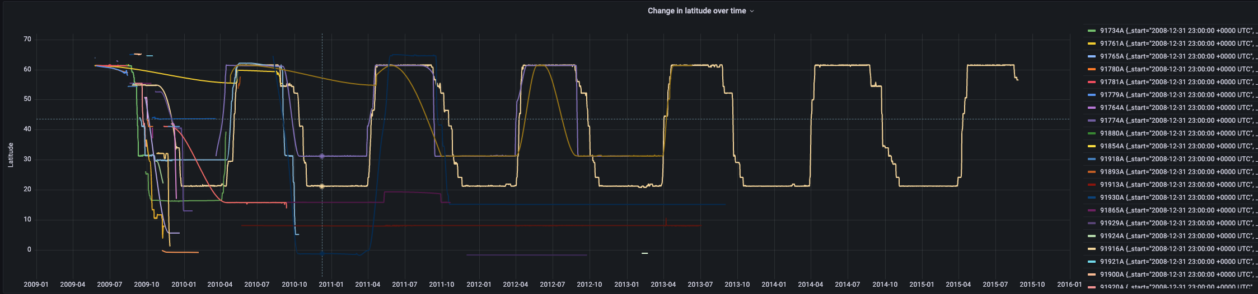
Project – visualization – Latitude over time
Grafana GeoMap & Heatmap – visualizing the data entries on a map
Filterable by time and by bird identifier

Slide 24
Project – classification
Predicting the season based on the bird‘s location
Mapping the data
Dataset only contains latitude and the timesta as possible identifier which have a really broad range of values
Values are mapped: Months to season and latitude to climate zone
Months | Season
12-02 | Winter
03-05 | Spring
06-08 | Summer
09-11 | Autumn
Latitude | Location
60-90 | Cold
40-60 | Mild
23.5-40 | Subtropical
0-23.5 | Tropical

Slide 25
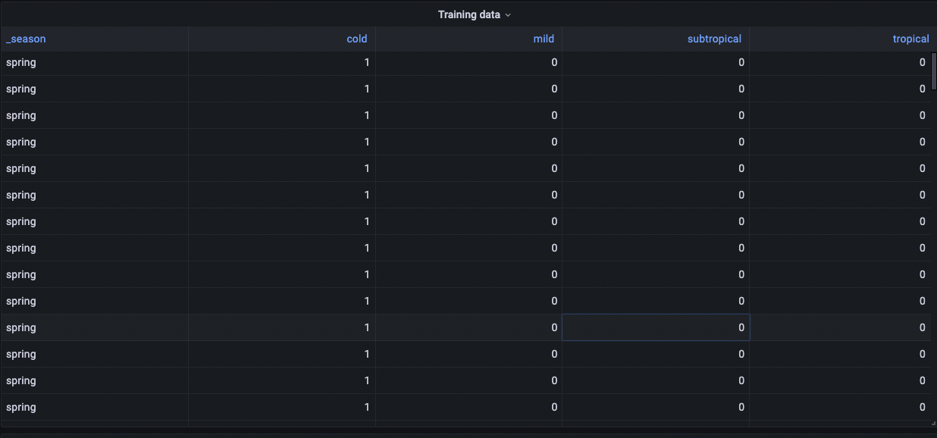
Project – classification – example calculation
Transforming the data to binary with class/field pairs as training data

Slide 26
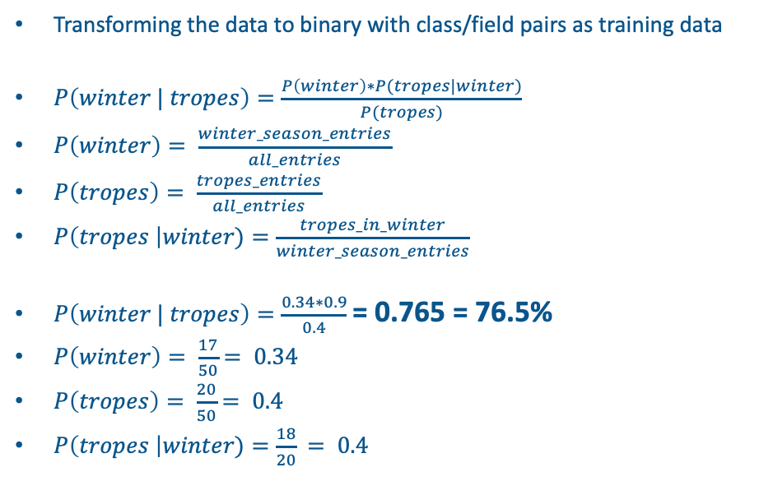
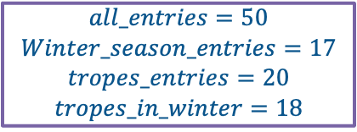
Project – classification – example calculation
Transforming the data to binary with class/field pairs as training data
$P\left(winter | tropes\right)=\frac{P\left(winter\right)∗P(tropes|winter)}{P(tropes)}$
$P\left(winter\right)= \frac{winter_season_entries}{all_entries}$
$P\left(tropes\right)= \frac{tropes_entries}{all_entries}$
$P\left(tropes \right|winter)=\frac{tropes_in_winter}{winter_season_entries}$
$P\left(winter | tropes\right)=\frac{0.34∗0.9}{0.4}$ = 0.765 = 76.5%
$P\left(winter\right)= \frac{17}{50}$ $= 0.34$
$P\left(tropes\right)= \frac{20}{50}$ $= 0.4$
$P\left(tropes \right|winter)=\frac{18}{20}$ $= 0.4$
Sample data:
$$all_entries=50$$
$$Winter_season_entries=17$$
$$tropes_entries=20$$
$$tropes_in_winter=18$$

Slide 27
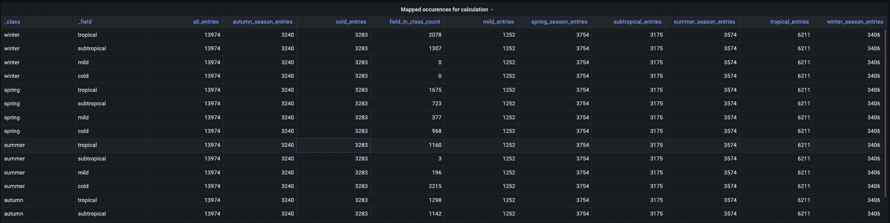
Project – classification – example calculation
Preprocess the training data to get every value needed for the calculation

Slide 28
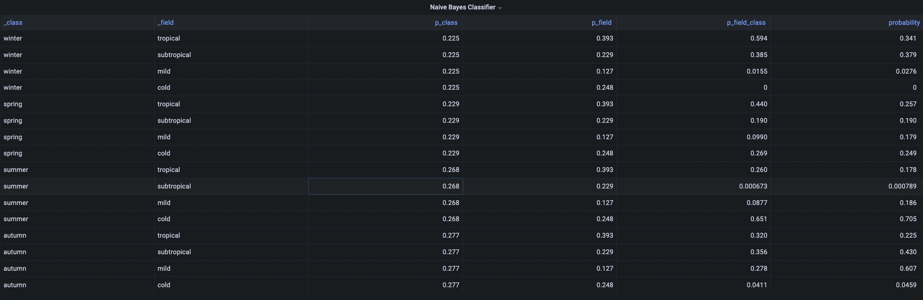
Project – classification – example calculation
Calculate the trained classifier for each Class given field:

Slide 29
4. Live Demonstration
Showing the Project and its results

Slide 30
5. Conclusion
Reflecting on the results

Slide 31
Conclusion
InfluxDB is an excellent tool for dealing with large datasets of time series data
Suitable for real-time analytics, also when combining it with its Python client library
The query language Flux is capable of performing extensive data analytics
Integration with Grafana and the visualization works very well

Slide 32
Outlook
Real-time streaming use case
Real-time analytics
Distribute the data store
Streaming IoT data

Slide 33
Repository
View the project at:
https://github.com/philippmoritzer/bd-ml-project

Slide 34
Thank you!

Slide 35
Sources 1
- [1] Brad Dayley. Sams Teach Yourself NoSQL with MongoDB in 24 Hours, Video Enhanced Edition. O'REILLY. 2014.
- [2] Kasun Idrasiri, Sriskandarajah Suhothayan. Design Patterns for Cloud Native Applications. O'REILLY. 2021.
- [3] CloudLab. NoSQL - CAP Theorem. Author unknown. Date unknown. URL: https://cloudxlab.com/assessment/displayslide/345/nosql-cap-theorem#:~:text=NoSQL%20can%20not%20provide%20consistency,Consistency%2C%20Availability%20and%20Partition%20Tolerance. (visited: 10.07.2022, 20:15)
- [4] Ted Dunning, Ellen Friedman. Time Series Databases: New Ways to Store and Access Data. O'REILLY. 2014.
- [5] Joe Reis, Matt Housley. Fundamentals of Data Engineering: Plan and Build Robust Data Systems. O'REILLYs. 2022.
- [6] Paul Dix. Why Build a Time Series Data Platform?. db-engines. 2017. https://db-engines.com/en/blog_post/71 (visited: 10.07.2022, 20:15)
- [7] Kovid Rathee. The case for using timeseries databases. 2021. URL: https://towardsdatascience.com/the-case-for-using-timeseries-databases-c060a8afe727 (visited: 10.07.2022, 20:15)
- [8] db-engines. InfluxDB System Properties. 2022. URL: https://db-engines.com/en/system/InfluxDB (visited: 10.07.2022, 20:15)
- [9] influxdata. influxdata - Documentation. 2022. URL: https://docs.influxdata.com/ (visited: 10.07.2022, 20:15)
- [10] influxdata. Get started with Flux. 2022. URL: https://docs.influxdata.com/influxdb/cloud/query-data/get-started/ (visited: 10.07.2022, 20:15)

Slide 36
Sources 2
- [11] Rohan Sreerama. A Deep Dive into Machine Learning in Flux: Naive Bayes Classification. 2020. URL: https://www.influxdata.com/blog/deep-dive-into-machine-learning-in-flux-naive-bayes-classification/ (visited: 10.07.2022, 20:15)
- [12] Igor Bobriakov. Prometheus vs InfluxDB. 2020. URL: https://www.metricfire.com/blog/prometheus-vs-influxdb/ (visited: 10.07.2022, 20:15)
- [13] db-engines. System Properties Comparison InfluxDB vs. Prometheus vs. TimescaleDB. 2022, URL: https://db-engines.com/en/system/InfluxDB%3BPrometheus%3BTimescaleDB (visited: 10.07.2022, 20:15)
- [14] United Manufacturing Hub. Why we chose timescaleDB over InfluxDB. 2022, URL: https://docs.umh.app/docs/concepts/timescaledb-vs-influxdb/
- [15] Team Magic. Building a Naive Bayes classifier using Flux. 2020. URL: https://github.com/RohanSreerama5/Naive-Bayes-Classifier-Flux/blob/master/Naive%20Bayes.pdf (visited: 10.07.2022, 20:15)
- [16] Rohan Sreerama. Naive-Bayes-Classifier-Flux. 2020. URL: https://github.com/RohanSreerama5/Naive-Bayes-Classifier-Flux (visited: 10.07.2022)

Slide 37
Image Sources (all accessed on: 17.07.2022, 15:00)
[1] Top 10 noSQL Databases: https://ares.decipherzone.com/blog-manager/uploads/ckeditor_Top%2010%20NoSQL%20Databases%20in%202022.png
[2] InfluxDB: https://dbdb.io/db/influxdb/revisions/7
[3] Prometheus: https://blogs.sap.com/wp-content/uploads/2018/01/prometheus.png
[4] TimescaleDB: https://3rdman.de/wp-content/uploads/Timescale.png

